Slide 1

jarred capellman | 4.19.2019

Slide 2
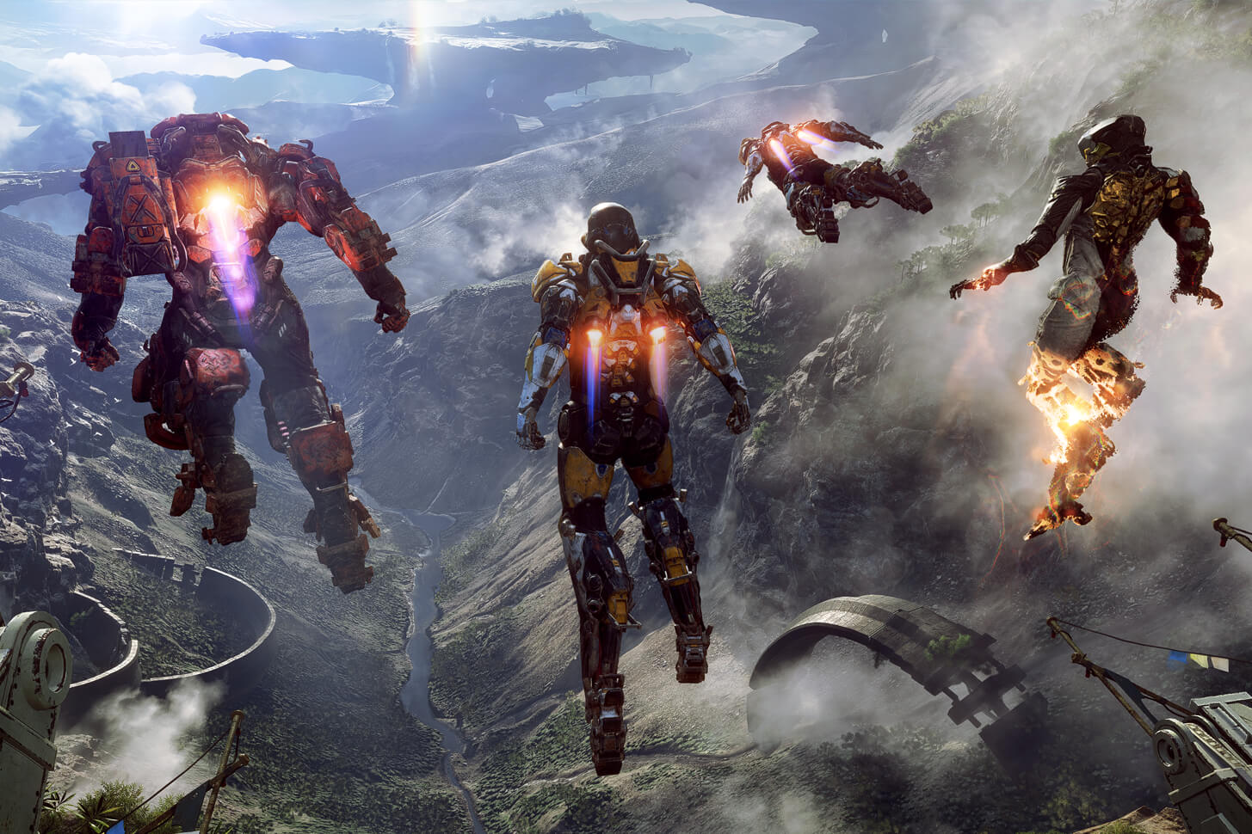

DREAM
REALITY

Slide 3


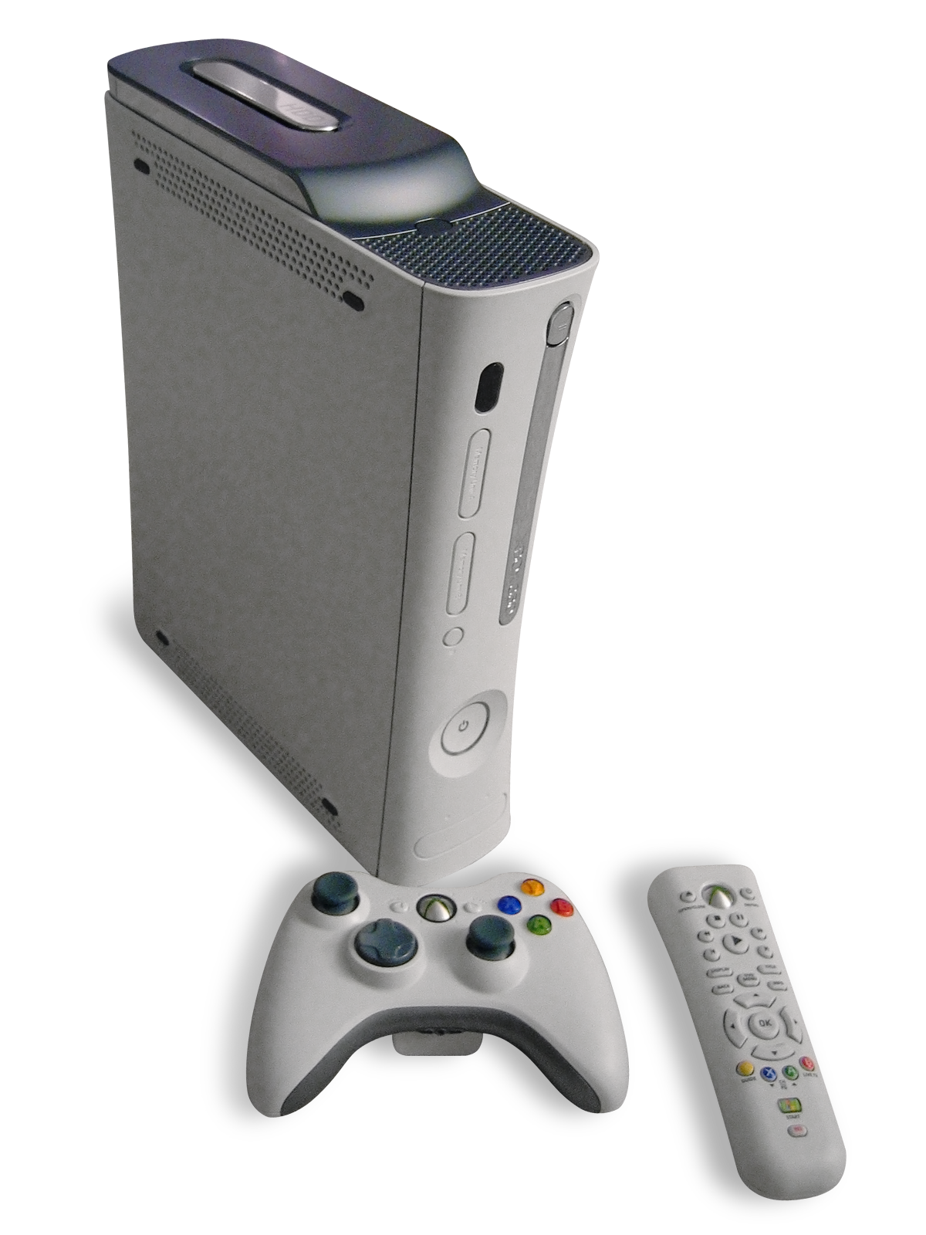
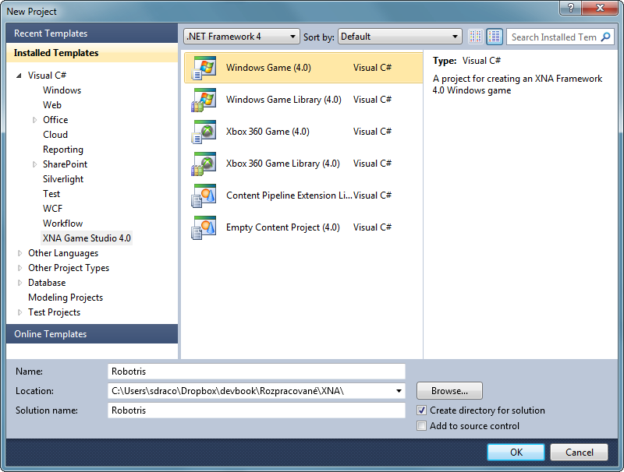




What is MonoGame?

Slide 4

How does Unity compare?
Unity offers a ready to go engine for 2D or 3D
Complexities of 2D might supersede MonoGame depending on the game
Documentation, Examples and Assets are plentiful
MonoGame is lacking in this regard
Licensing Model is Free up to 100k
MonoGame is MIT License

Slide 5








Targeted platforms
*PS4, Xbox One and Nintendo Switch require developer program registration

Slide 6
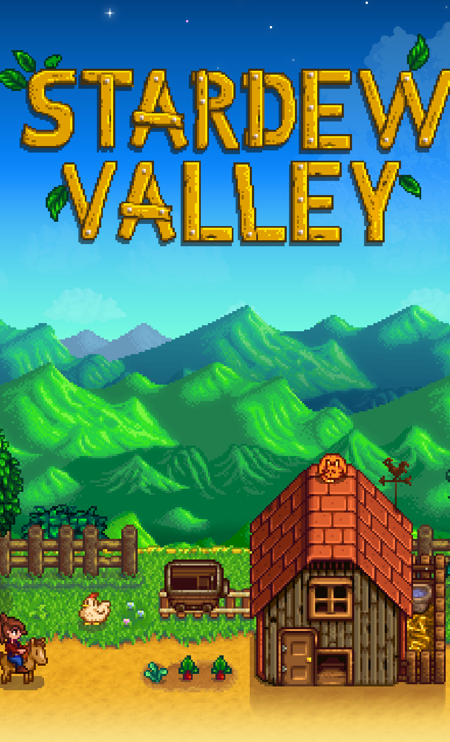

Published MonoGame Titles (1000+)

Slide 7
MonoGame Structure
Content Pipeline
Game Class
Rendering
Input
Updates

Slide 8
CREATING A GAME WITH MONOGAME

Slide 9
High Level Game Design Questions
Perspective
2D
3D
Control Mechanisms
Mouse
Keyboard
Controller
Targeted platforms
Mobile
Console
Desktop

Slide 10

Things to keep in mind
Resolution Scaling
Use Highest Resolution Assets available
Architect up front
Long term time savings
Playtest early and often

Slide 11
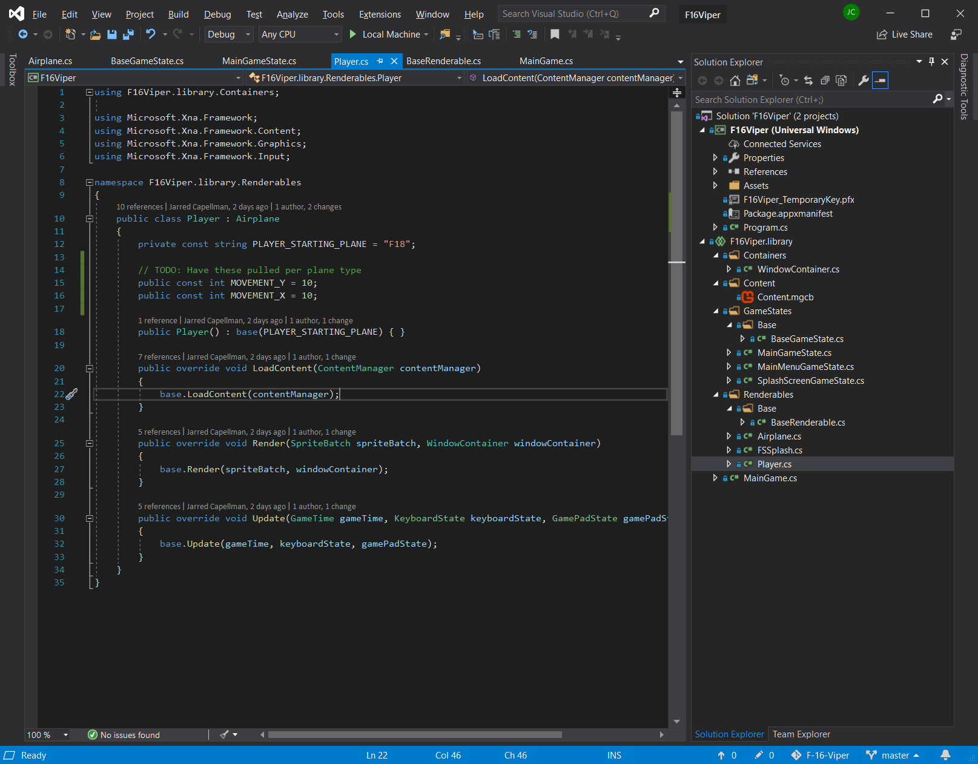
demo | code deep dive

Slide 12
MonoGame Resources
A new book coming later this year (From beginner to advanced)
GitHub:
https://github.com/MonoGame/MonoGame.Samples

